Slide 1


West Niagara ISL
Team Management

Slide 2
About E2E Soccer
Company was founded in 2003
We are located in Ottawa
We provide IT solutions for the soccer community
Our products allow our customers to automate their operations in a cost-effective manner
Our goal is to provide the customer with an end to end or E2E solution

Slide 3
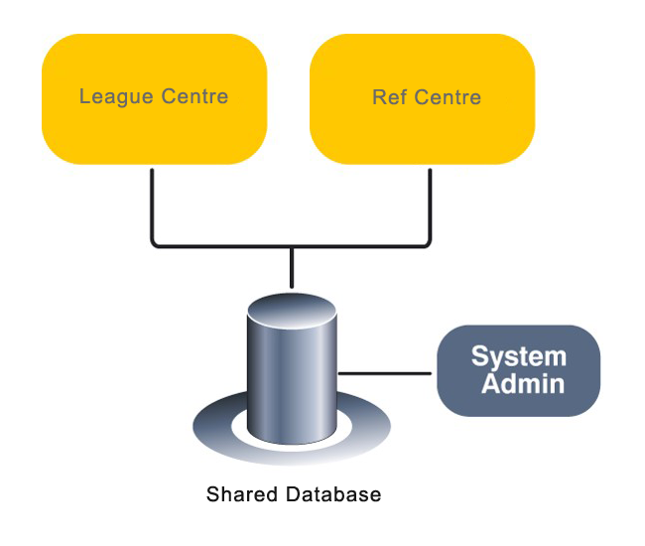
The WNISL solution

Slide 4





League management roles and responsibilities
League staff Club staff Team staff Players
Generate schedule
Review game sheets
Discipline management
Operate the league
Team oversight
Create club rosters
Approve call ups
Club management
Generate game sheets
Submit game reports
Request call ups
Manage reschedules
Read only

Slide 5
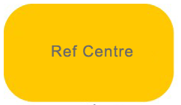


Referee management roles and responsibilities
League staff Club staff Assigner Referees
Referee oversight
Pay referees
Referee oversight
Pay referees
Assign referees
Support referees
Accept game offers
Submit game reports
Submit discipline
Upload game sheets

Slide 6
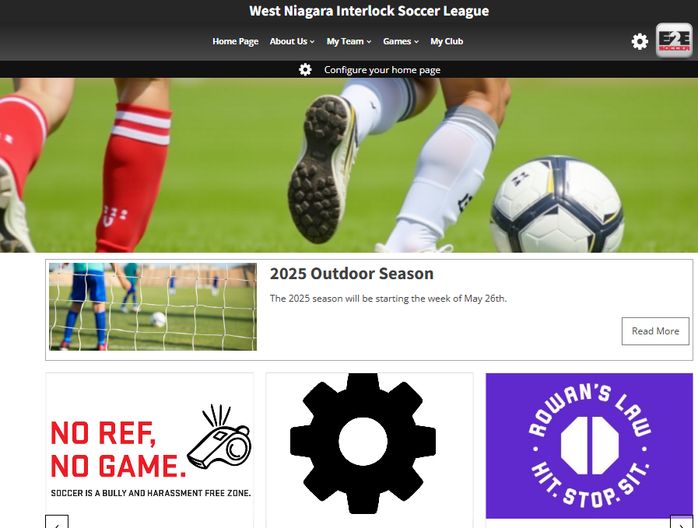
The WNISL website is now at
https://wnisl.com/

Slide 7
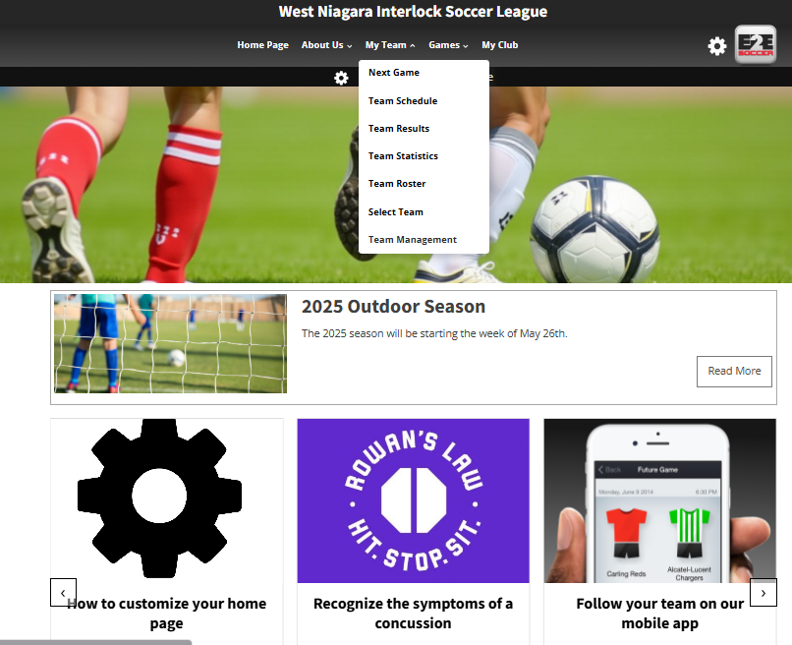
Each team manager and coach is
required to set up an account with
the site.
To do this go to the My Team and select Team Management

Slide 8
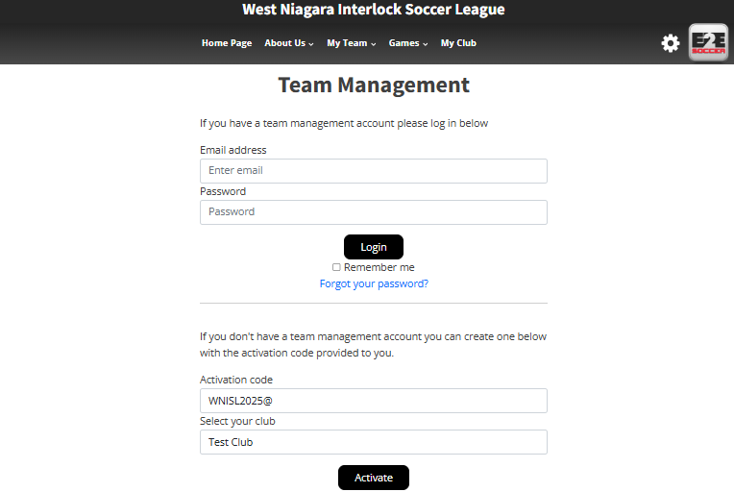
To activate your account, go here
and enter this activation code.
WNISL2025@ (case sensitive)
Choose your club's name from the drop-down menu
Then click the Activate button

Slide 9
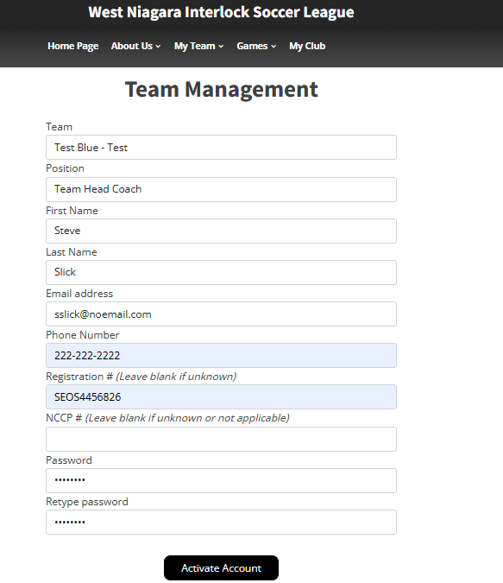
Make sure that you select the correct
team here
Fill in the rest of the page and click the
Activate Account button

Slide 10
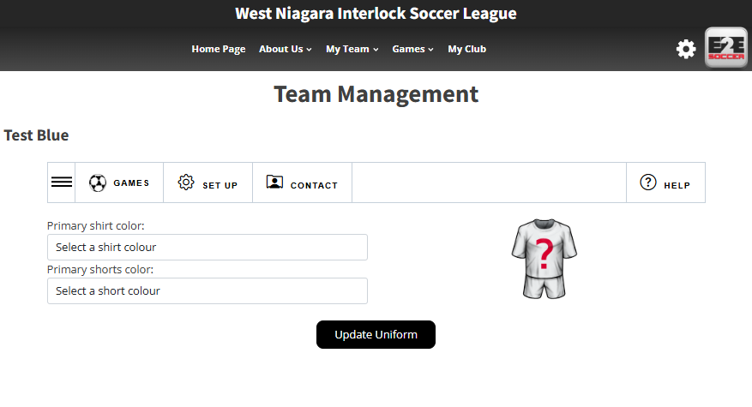
You will now be taken to the Team
Management module
There are 4 tabs in this module
Games
Set Up
Contact
Help
Click on the 3 lines to open the submenus for each tab.

Slide 11
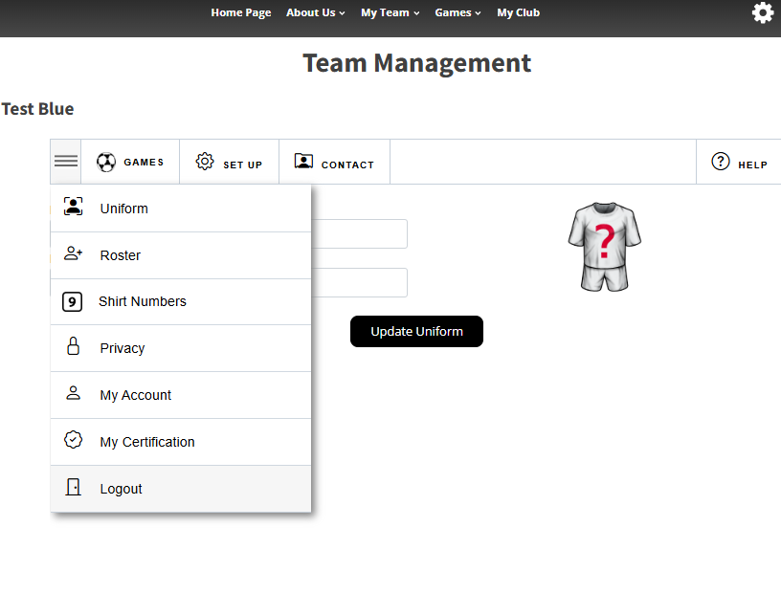
In each tab is a series of tools
Click on the button to visit that tool

Slide 12
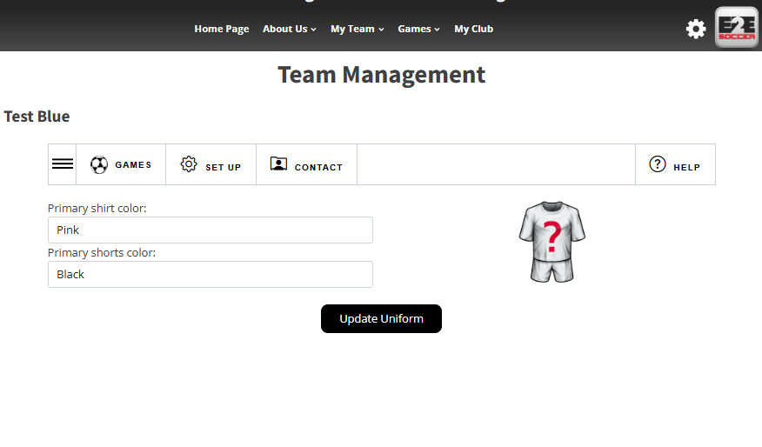
Start in the Set Up menu
First enter your uniform by selecting
your shirt and shorts in the drop downs
Click the Update Uniform button to save

Slide 13
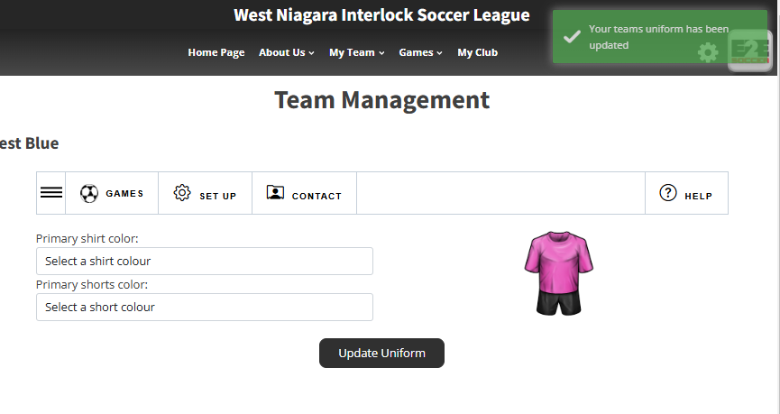
A green message will tell you that the
action was successful
It will be red if there is a problem

Slide 14
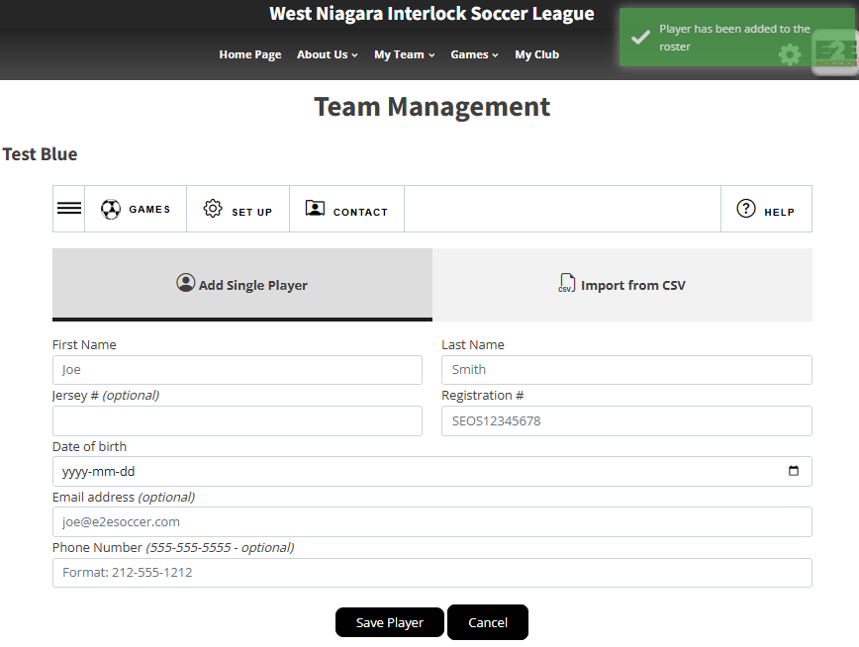
Now stay in the set-up menu and select
the Roster tool
Now enter your players
You can add them one at a time
or
You can import a csv file of your roster
Again, note the green box indicating my player was added to my roster.

Slide 15
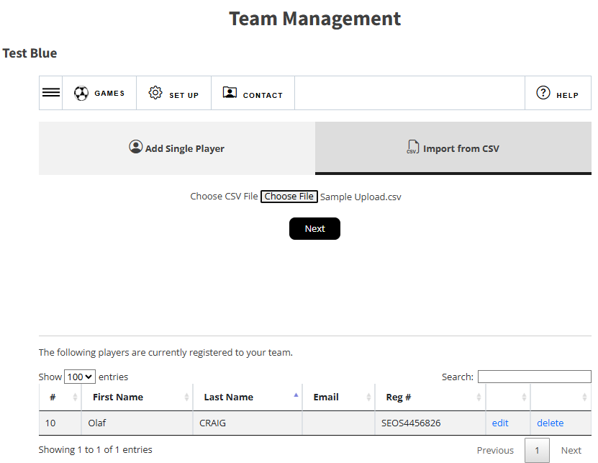
Adding Your Roster
This can be done individually or through an CSV file.
To upload by CSV, click on the tab to Import
Choose the file from your computer. There is no template, but a sample is able on the next slide
Click Next.

Slide 16
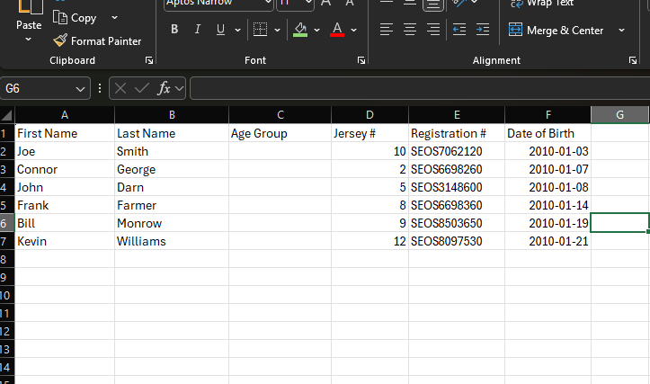
This is the ideal setting for your upload.

Slide 17
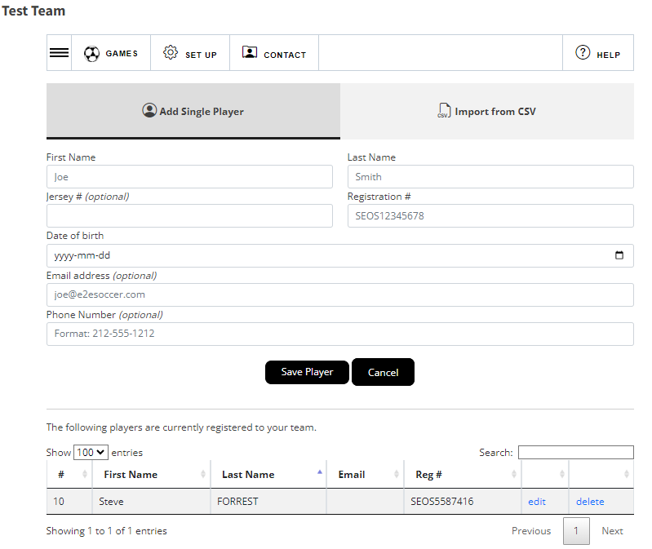
After the player has been added
he or she will be listed in the table
below the buttons
If you need to edit or delete the
player use these links
Jersey numbers can be edited or added here as well.

Slide 18
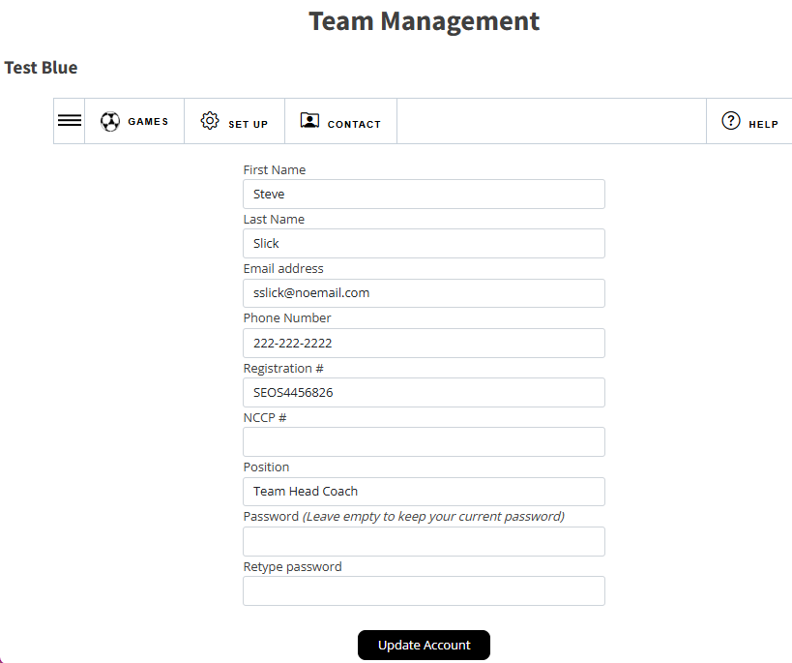
My Account information can be updated including your password.

Slide 19
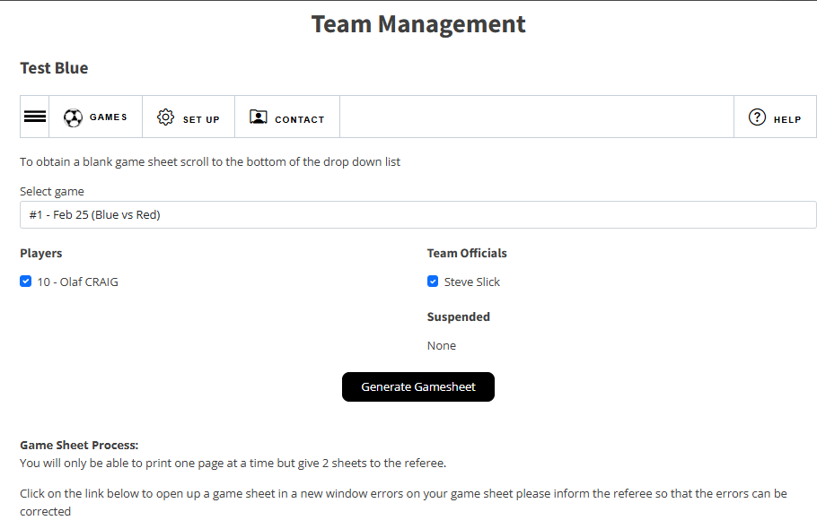
After you have entered your roster
you can create a gamesheet
To do this go to the Games tab.
Click the 3 lines icon to see the options under Games, click gamesheets.
Choose your players who will be attending the game and click Generate Gamesheet
A gamesheet will appear in a new
window.
Print it out and bring it to the game

Slide 20
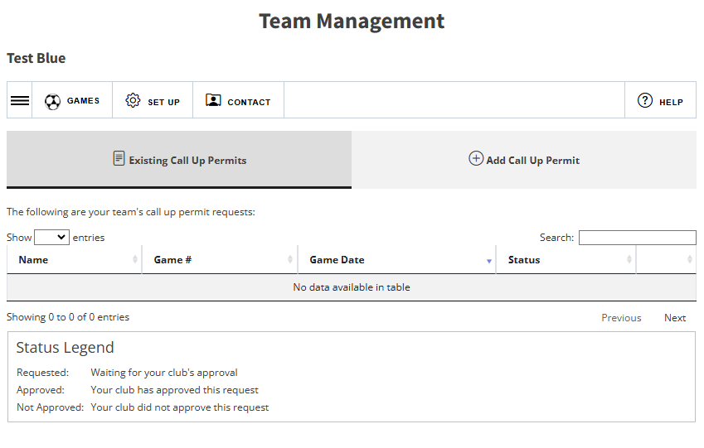
If Call Up’s are required, go to Games/Call Ups.
You can view the existing call ups.
To add a Call Up Permit click on the tab.

Slide 21
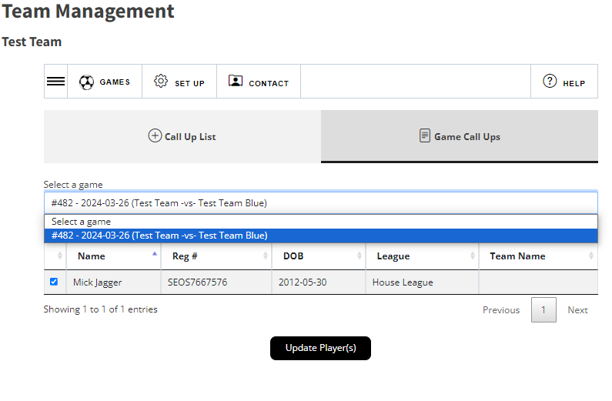
Select a game from your schedule.
Click the box beside the player’s name, click update player(s).
A green message in the upper right corner will confirm it being added to the roster for the game.
Your club will have to approve the call up for them to appear on the game sheet.
Note: The League will not approve call ups on behalf of the club.

Slide 22
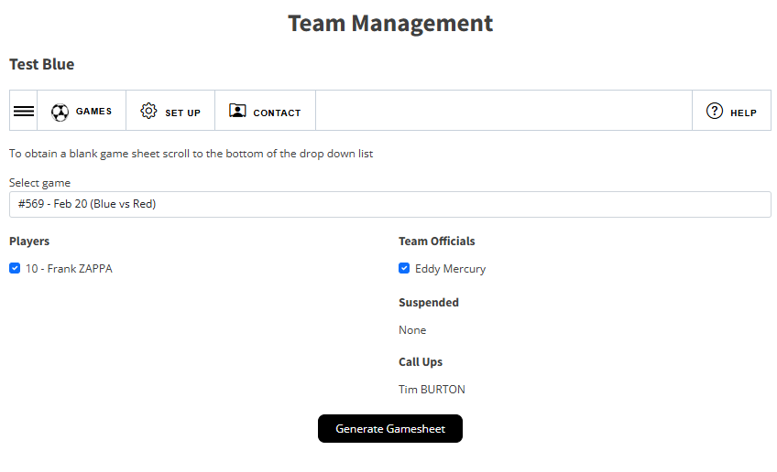
Once your call up has been approved they will be listed under the Call Up section to generate your game sheet.
Check the players who will be attending the game.

Slide 23
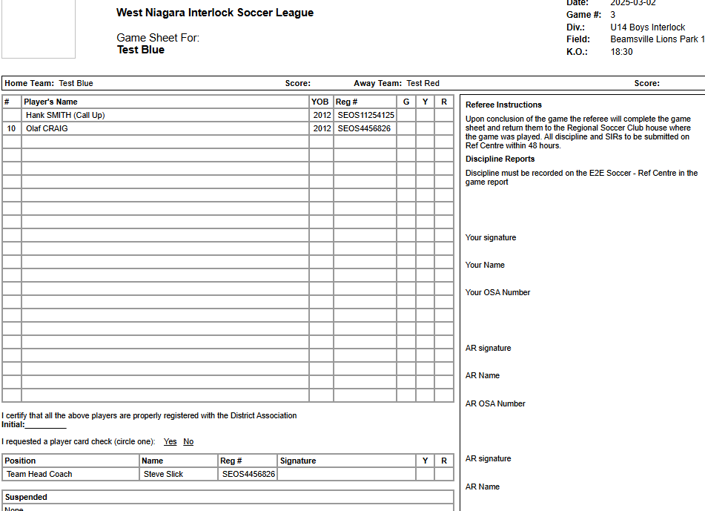
Sample gamesheet

Slide 24
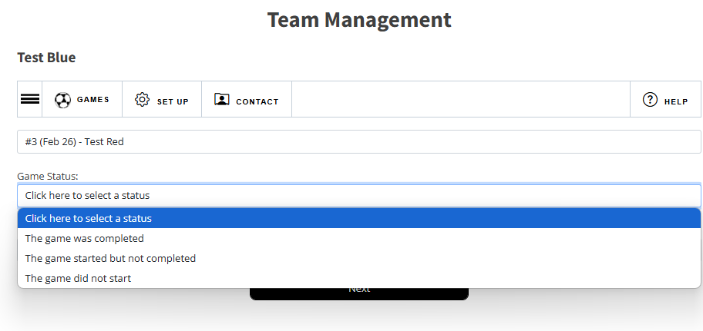
After the game go to the Game Report tool to submit a report
Follow the instructions to completion
When both teams have entered a game report the standings will be updated

Slide 25
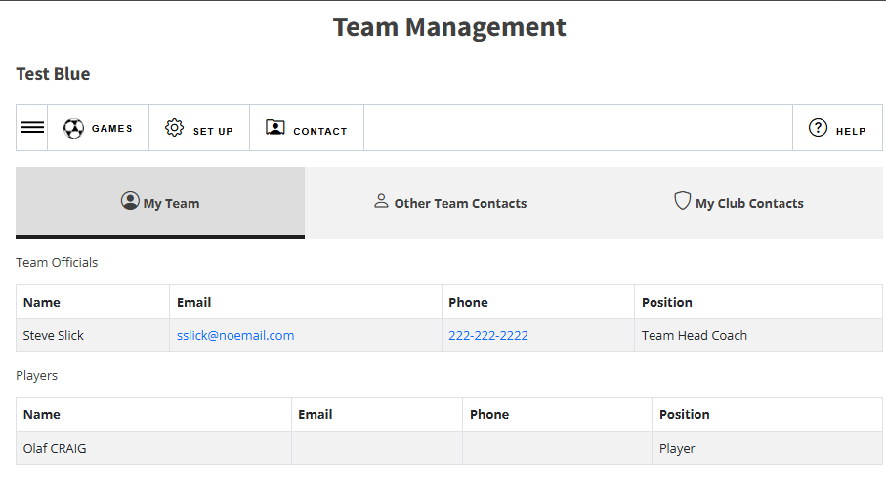
When you click on Contact, there are 2 tabs:
My Team
Other Team Contacts
Please use this when contacting your team or opponents.
Please contact the WNISL staff in you need assistance setting up your Team Management account

